Slide 1
Software Cost Estimation & Quality Assurance

Slide 2
Software cost components
Three parameters to compute total cost of software development project:
Hardware and software costs including maintenance.
Travel and training costs.
Effort costs (the dominant factor in most projects)
-The salaries of engineers involved in the project;
-Social and insurance costs.
Effort costs must take overheads into account
- Costs of building, heating, lighting.
-Costs of networking and communications.
- Costs of shared facilities (e.g library, staff restaurant, etc.).

Slide 3
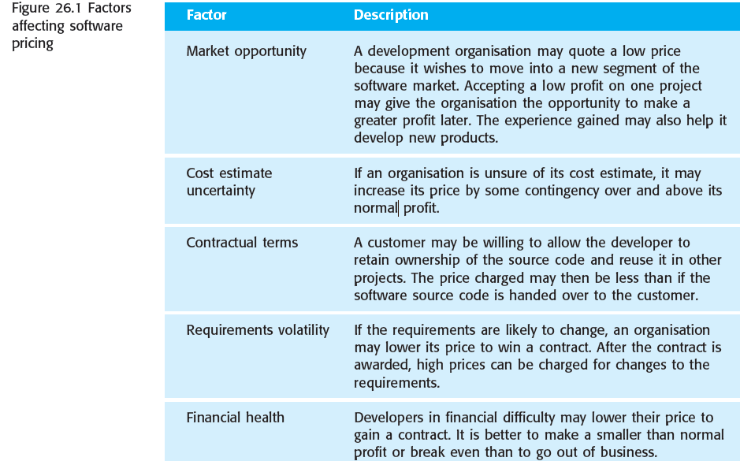
Software pricing factors

Slide 4
Estimation techniques
There is no simple way to make an accurate estimate of the effort required to develop a software system.
-Initial estimates are based on inadequate information in a user requirements definition;
-The software may run on unfamiliar computers or use new technology;
- The people in the project may be unknown.
-Project cost estimates may be self fulfilling
- The estimate defines the budget and the product is adjusted to meet the budget.

Slide 5
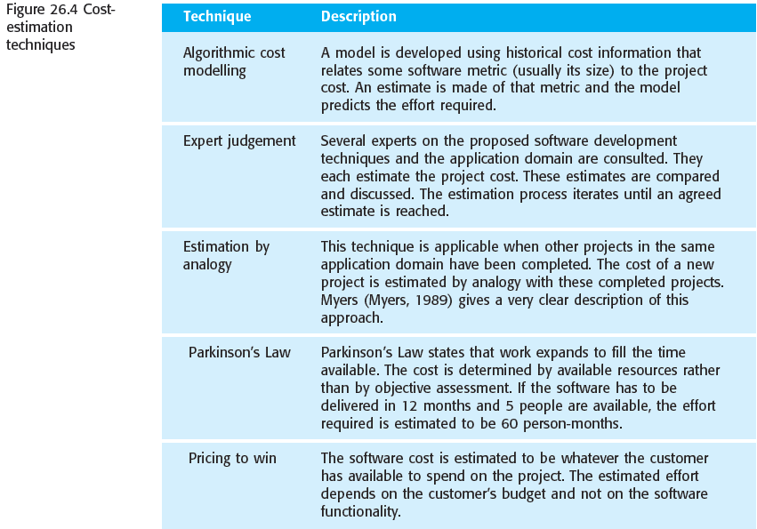

Slide 6
Algorithmic cost modeling
Algorithmic cost modeling uses a mathematical formula to predict project costs based on estimates of the project size, the number of software engineers, and other process and product factors.
An algorithmic cost model can be built by analyzing the costs and attributes of completed projects and finding the closest fit formula to actual experience.
An algorithmic cost estimate for software cost can be expressed as:
Effort = A *Size^B * M
A is a constant factor, Size may be either an assessment of the code size of the software or a functionality estimate expressed in function or object points, value of exponent B usually lies between 1 and 1.5. M is a multiplier made by combining process, product and development attributes.

Slide 7
Algorithmic cost modeling
Most algorithmic estimation models have an exponential component (B in the above equation) that is associated with the size estimate.
This reflects the fact that costs do not normally increase linearly with project size. As the size of the software increases, extra costs are incurred because of the communication overhead of larger teams, more complex configuration management, more difficult system integration, and so on.
Therefore, the larger the system, the larger the value of this exponent.

Slide 8
Algorithmic cost modeling
All algorithmic models suffer from the same fundamental difficulties:
1. It is often difficult to estimate Size at an early stage in a project when only a specification is available. Function-point and object-point estimates are easier to produce than estimates of code size but are often still inaccurate.
2. The estimates of the factors contributing to B and M are subjective. Estimates vary from one person to another, depending on their background and experience with the type of system that is being developed.

Slide 9
The COCOMO (Constructive Cost Model)
Boehm proposed COCOMO (Constructive Cost Estimation Model) in 1981.COCOMO is one of the most generally used software estimation models in the world. COCOMO predicts the efforts and schedule of a software product based on the size of the software.
To determine the initial effort Ei in person-months the equation used is of the type is shown below
Ei=a*(KDLOC)b

Slide 10
The necessary steps in this model are:
Get an initial estimate of the development effort from evaluation of thousands of delivered lines of source code (KDLOC).
Determine a set of 15 multiplying factors from various attributes of the project.
Calculate the effort estimate by multiplying the initial estimate with all the multiplying factors i.e., multiply the values in step1 and step2.

Slide 11
In COCOMO, projects are categorized into three types:
1.Organic: A development project can be treated of the organic type, if the project deals with developing a well-understood application program, the size of the development team is reasonably small, and the team members are experienced in developing similar methods of projects. Examples of this type of projects are simple business systems, simple inventory management systems, and data processing systems.
2. Semidetached: A development project can be treated with semidetached type if the development consists of a mixture of experienced and inexperienced staff. Team members may have finite experience in related systems but may be unfamiliar with some aspects of the order being developed. Example of Semidetached system includes developing a new operating system (OS), a Database Management System (DBMS), and complex inventory management system.
3. Embedded: A development project is treated to be of an embedded type, if the software being developed is strongly coupled to complex hardware, or if the stringent regulations on the operational method exist. For Example: ATM, Air Traffic control.

Slide 12
According to Boehm, software cost estimation should be done through three stages:
Basic Model
Intermediate Model
Detailed Model

Slide 13
1. Basic COCOMO Model: The basic COCOMO model provide an accurate size of the project parameters. The following expressions give the basic COCOMO estimation model:
Effort=a1*(KLOC) a2 PM
Tdev=b1*(efforts)b2 Months
Where
KLOC is the estimated size of the software product indicate in Kilo Lines of Code, a1,a2,b1,b2 are constants for each group of software products,
Tdev is the estimated time to develop the software, expressed in months, Effort is the total effort required to develop the software product, expressed in person months (PMs).

Slide 14
Estimation of development effort
For the three classes of software products, the formulas for estimating the effort based on the code size are shown below:
Organic: Effort = 2.4(KLOC) 1.05 PM
Semi-detached: Effort = 3.0(KLOC) 1.12 PM
Embedded: Effort = 3.6(KLOC) 1.20 PM

Slide 15
Estimation of development time
For the three classes of software products, the formulas for estimating the development time based on the effort are given below:
Organic: Tdev = 2.5(Effort) 0.38 Months
Semi-detached: Tdev = 2.5(Effort) 0.35 Months
Embedded: Tdev = 2.5(Effort) 0.32 Months

Slide 16
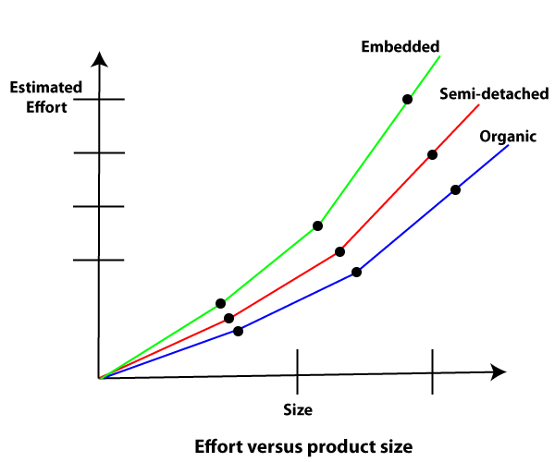
Some insight into the basic COCOMO model can be obtained by plotting the estimated characteristics for different software sizes.

Slide 17
Example1: Suppose a project was estimated to be 400 KLOC. Calculate the effort and development time for each of the three model i.e., organic, semi-detached & embedded.
(i)Organic Mode
E = 2.4 * (400)1.05 = 1295.31 PM
D = 2.5 * (1295.31)0.38=38.07 PM
(ii)Semidetached Mode
E = 3.0 * (400)1.12=2462.79 PM
D = 2.5 * (2462.79)0.35=38.45 PM
(iii) Embedded Mode
E = 3.6 * (400)1.20 = 4772.81 PM
D = 2.5 * (4772.8)0.32 = 38 PM

Slide 18
Intermediate Model:
The basic Cocomo model considers that the effort is only a function of the number of lines of code and some constants calculated according to the various software systems. The intermediate COCOMO model recognizes these facts and refines the initial estimates obtained through the basic COCOMO model by using a set of 15 cost drivers based on various attributes of software engineering.
Intermediate COCOMO equation:
E=ai (KLOC) bi*EAF
D=ci (E)di

Slide 19
Detailed COCOMO
Detailed COCOMO incorporates all qualities of the standard version with an assessment of the cost driver?s effect on each method of the software engineering process. The detailed model uses various effort multipliers for each cost driver property. In detailed cocomo, the whole software is differentiated into multiple modules, and then we apply COCOMO in various modules to estimate effort and then sum the effort.
The Six phases of detailed COCOMO are:
Planning and requirements
System structure
Complete structure
Module code and test
Integration and test
Cost Constructive model

Slide 20
Six Sigma for Software Engineering
Six Sigma is the most widely used strategy for statistical quality assurance. The Six Sigma strategy “is a rigorous and disciplined methodology that uses data and statistical analysis to measure and improve a company’s operational performance by identifying and eliminating defects’ in manufacturing and service-related processes.
The Six Sigma methodology defines three core steps:
-Define customer requirements and deliverables and project goals via well defined methods of customer communication.
- Measure the existing process and its output to determine current quality performance (collect defect metrics).
- Analyze defect metrics and determine the vital few causes.

Slide 21
Six Sigma for Software Engineering
If an existing software process is in place, but improvement is required, Six Sigma suggests two additional steps:
- Improve the process by eliminating the root causes of defects.
-Control the process to ensure that future work does not reintroduce the causes of defects.
If an organization is developing a software process (rather than improving an existing process), the core steps are augmented as follows:
-Design the process to:
avoid the root causes of defects and
to meet customer requirements.
- Verify that the process model will, in fact, avoid defects and meet customer requirements

Slide 22
The ISO 9000 Quality Standards
ISO(International Organization for Standardization) 9000 is a set of international standards on quality management and quality assurance developed to help companies effectively document the quality system elements to be implemented to maintain an efficient quality system. They are not specific to any one industry and can be applied to organizations of any size.
Individuals and organizations cannot be certified to ISO 9000. ISO 9001 is the only standard within the ISO 9000 family to which organizations can certify.

Slide 23
ISO 9000 principles of quality management
The ISO 9000:2015 and ISO 9001:2015 standards are based on seven quality management principles that senior management can apply for organizational improvement:
Customer focus
Leadership
Engagement of people
Process approach
Improvement
Evidence-based decision making
Relationship management

Slide 24
SEI CMM
CMM stands for Capability Maturity Model.
Focuses on elements of essential practices and processes from various bodies of knowledge.
CMM is a method to evaluate and measure the maturity of the software development process of an organizations.
CMM measures the maturity of the software development process on a scale of 1 to 5.
CMM v1.0 was developed by the Software Engineering Institute (SEI) at Carnegie Mellon University in Pittsburgh, USA.

Slide 25
CMM's Five Maturity Levels
CMM's Five Maturity Levels of Software Processes:
At the initial level, processes are disorganized, even chaotic. Success is likely to depend on individual efforts, and is not considered to be repeatable, because processes would not be sufficiently defined and documented to allow them to be replicated.
At the repeatable level, basic project management techniques are established, and successes could be repeated, because the requisite processes would have been made established, defined, and documented.

Slide 26
CMM's Five Maturity Levels
At the defined level, an organization has developed its own standard software process through greater attention to documentation, standardization, and integration.
At the managed level, an organization monitors and controls its own processes through data collection and analysis.
At the optimizing level, processes are constantly being improved through monitoring feedback from current processes and introducing innovative processes to better serve the organization's particular needs.

Slide 27
Difference between ISO 9000 and CMM(ISO 9000 VS CMM)
ISO 900(INTERNATIONAL STANDARD ORGANISATION) | CMM (CABABILITY MATURITY MODEL)
ISO certification is usually prompted because certification is needed to get contracts. | CMM review is usually done to improve and involves a more detailed study than does an ISO review.
Continuous improvement is almost totally absent. It merely addresses the control of a nonconforming product and recommends corrective and preventive action. | Software products are inherently complex and challenging to scope, develop, implement, verify, validate, and maintain. This requires a total quality approach focused on customer satisfaction and continuous improvement.

Slide 28
Difference between ISO 9000 and CMM(ISO 9000 VS CMM)
ISO 900(INTERNATIONAL STANDARD ORGANISATION) | CMM (CABABILITY MATURITY MODEL)
It applies to any type of industry . | CMM is specially developed for software industry.
ISO 9000 provides pass or fail criteria. | It provides grade for process maturity.
ISO 9000 has no levels. | CMM has 5 levels: -Initial -Repeatable -Defined -Managed -Optimization

